Slide 1
How much Udi is Udi? Or: What do we describe when we describe a language?
2. pracovné stretnutie vedeckovýskumného tímu Centra pre jazyk a jazykovú prax
Wolfgang Schulze
14.06.2016

Slide 2
Basic Question
What is ‚a language‘?
Scientific view
Internal view
External view

Slide 3
Basic Question
Is language a „structural‘ phenomenon?
Or:
Is ‚language‘ the total of the linguistic practices of a social group?
=> ‚System Linguistics‘ vs. ‚Sociolinguistics‘

Slide 4
Ethnicity
How to define Ethnicity?
Group-internal view: Social unit, that construes and maintains a collective identity based on a bundle of distinctive features present in the traditional and conventionalized sociocultural knowledge patterns of the community.
- Each group defines the relevance of the corresponding features differently. The way people do this is again part of the cultural knowledge of the community.

Slide 5
Ethnicity
Prototypical:
- Collective knowledge: Conventionalized knoweldge about social, cultural, and economic practices and about the ‚interpretation of the world‘.
- History: Genealogical identity.
- Regionality: Attribution of a regional (also mythological) homeland to the given community.
- Institutionalization: ‚Administration‘ of traditional knowledge by a specific group within the community

Slide 6
Ethnicity
External view:
Construction of ‚experiences of difference‘ by a commnunity with regard to other communities.
=> Stereotyping und classification of ‚otherness‘ with the help of the community‘s patterns of ethnicity.
=> Identification of other rulerships as entailing a different ‚ethnic‘ pattern.

Slide 7
Language
Internal view:
Social knowledge: Language as a part of social interactional patterns (communication).
But: Language is not a necessary part of construing ‚ethnicity‘!
But: Language may support the stabilization of ethnicity constructions.
This does not necessarily mean that an ethnic group should be marked for one language (cf. multilingual ethnic groups).

Slide 8
Language
Language and Power:
“a shprakh iz a dialekt mit an armey un flot.“
‚A language is a dialect with an army and a navy‘) (Weinreich 1945: 13)

Slide 9
Language
External view:
Societies may (!) related to experiecne of differences in communicative practices as being part of a bundle of ethnic markers.
But: This is not a ‚must‘!
- It happens especially if the given society sees itss own system of linguistic practices as constituing a relevant part of their ethnicity.

Slide 10
Getting started
1. Language does not exist ‚by itself‘, but only in terms of socially controlled linguistic practices grounded in a more or less collective knowledge system.
2. Documenting a language means to document linguistic practices as they are (and not as they should be).
3. ‘Languages’ are usually endangered because speakers have the option to profile their linguistic practices with respect to ‘another’ linguistic knowledge system acquired more or less in parallel during the process of language acquisition.
4. Hence, the question is how to delimit the ‘languages’ involved in observed linguistic practices.

Slide 11
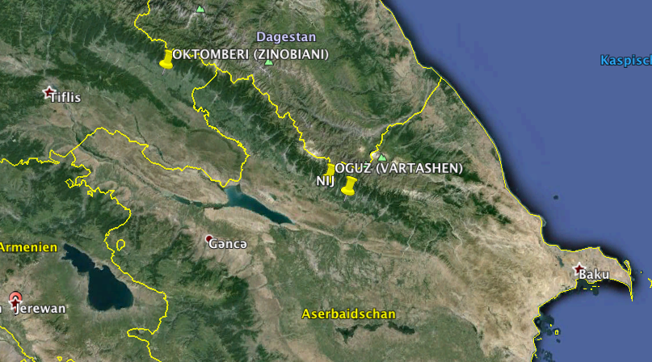
Udi (1)
Udi: Spoken/known by roughly 8.000 people
- Village of Nij in Northern Azerbaijan (3.000)
- Village of Oguz (Vartashen) in Northern Azerbaijan (50 ?)
- Village of Oktomberi/Zinobiani (since 1922) in Eastern Georgia (150)
- Diaspora in Russia, Armenia, Kazakhstan etc. (3.500)

Slide 12
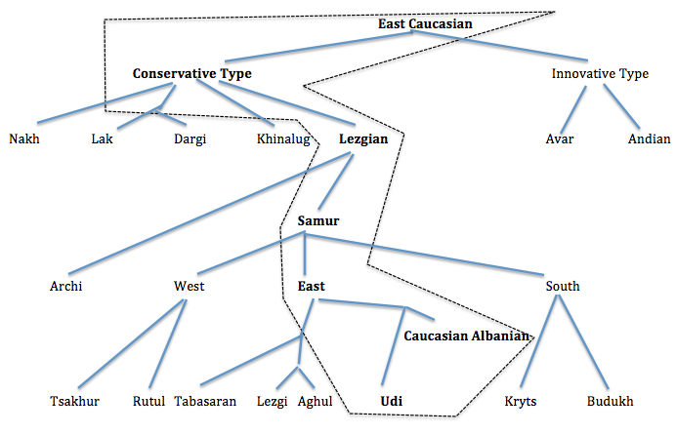
Udi (1)
Udi: Traditionally defined as an East Caucasian language belonging to the Southeast Caucasian (Lezgian) group:
Tsezic

Slide 13
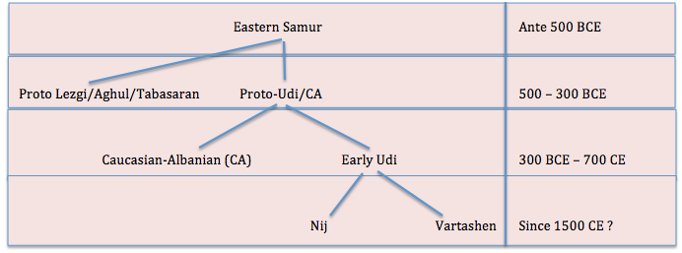
Udi (1)
Two dialects:
- Vartashen (Oguz, Oktomberi (sub-variety), Diaspora)
- Nij (Nij, Diaspora)
Udi: ‚Niece‘ (or ‚daughter‘ ?) of Caucasian Albanian:

Slide 14
Udi (1)
Language contact (as far as data go!):
500 BCE – 700 CE: Strong contact with older Northwest Iranian varieties (Medic, Parthian etc.)
400 CE – 700 CE: Strong impact from Old Armenian, accompanied by impact from Old Georgian
700 CE – 1990: Stabilized contact with local Middle East and Modern East Armenian varieties, local Iranian varieties (esp. Tati in the Vartashen region)
700 CE: Beginning ‚Orientalization‘ of Udi (Arabic, early Azerbaijani varieties, Persian); massive Azertification
1850 – 1990: Partial intrusion of Russian
1990 till now: Ongoing Azerification, ‚De-Armenzation‘ of Udi

Slide 15
Observation
Udi (Nij)
däniz-ä gele ost’ahar tufan-e bak-sa
sea-LOC much strong storm-3SG become-PRES
’There comes up a strong storm on the sea.’ (Jona 1.4)
(Translation by translator group in Nij 2009)
Azeri: dǝnizde böyük bir fırtına qopdu
Loans: däniz (Azeri), gele (NW-Iranian), ost’ahar (Persian), tufan (Turkic)
Native: bak(-sun)
Question: Which language is present in this phrase?
Udi? Azeri? Mixed language?
What is endangered in Udi?

Slide 16
Caucasian Albanian
A (re-?)discovered forerunner of Udi
CAUCAUSIAN ALBANIAN
Re-implemented in Udi society by Udi intelligentsia (following official programmatics) as being part of the Udi cultural traditions.

Slide 17
Caucasian Albanian
Religious and (seemingly) ‚official‘ language in the kingdom of Caucasian Albania (100 BCE – 705 CE), christianized in the 4th-5th century).
Script: Proper script (part of the Transcaucasian Mashtots-script tradition)
Sample:
Documents:
a) Seven very short inscriptions
b) ‚Caucasian Albanian Palimpsests‘ (found in the Catharine monastary, Sinai in 2000, identified as ‚Caucasian Albanian‘ by Zaza Aleksidze, deciphered and edited by Jost Gippert and Wolfgang Schulze (2003-2009).

Slide 18
Caucasian Albanian
The Mingechaur pedestal
(558 CE ?)
[Gippert, Schulze et al.2009, I: II,86]

Slide 19
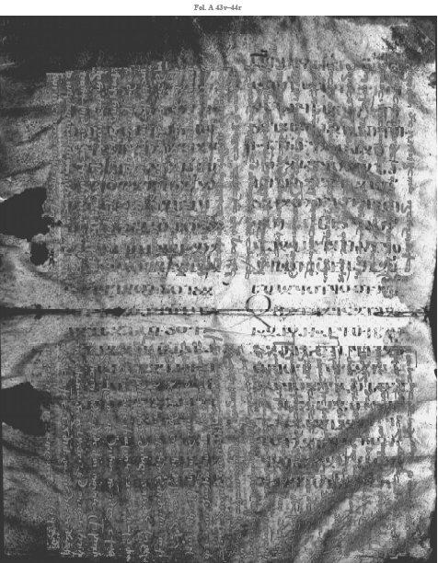
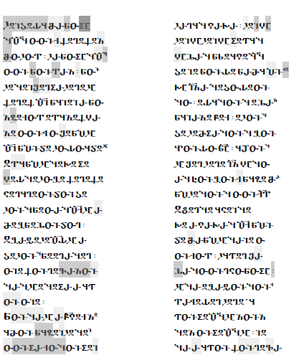
Caucasian Albanian
Sample of Palimpsest (Lk 4,29-36)
[Gippert, Schulze et at. 2009, II: VI, 38-39]

Slide 20
Udi (2)
Some cultural features:
L1-aquisition: Traditional bilingualism/multilingualism
Religion: Christian (unclear affiliation; historically monophysite, strong dyophysite tendencies in Varatshen since 1820); grwoing impact from Russian Orthodoxy since 1989.
Economics: No specific profile farming, cattle breeding, rice cultivation, sericulture, horticulture, poultry farming, craftsmanship and viticulture)
Feasts and rites: Christian patterns strongly accommodated to Islamic environment (e.g. komrad festival => Qurban, žoğulun axc´ibay => Novruz)
Kinship structure: Traditional Oriential
Food and Dishes: Locally elaborated „Oriental“ (note: allowance of pig meat)
Marriage patterns: Historically (1820-1989) intermarriage between Nij and Vartashen Udis was stigmatized (as well as between Udis and Armenians in Vartashen)
Linguistic Camouflage: E.g. greeting as-salâm ^{c}aleykum etc. instead of (older) xeyrq´anbake ‚you will/shall be blessed‘
Naming (surnames): Historically often Armenian (e.g. Lukasyan) or Russian (e.g. Bežanov), now Azeri (Lukasoğlu), Georgian in Oktomeri (Džejranišvili)
Naming of Nij quarters: Azeri (Hajibayli, Darabag, Daramahla, Vazirli, Farimli, Malbel, Agdamekli, Melikli, Falshyly, Manjyly, Delekli, Chirmakhli, Abdally)
Traditional music: Azerbaijani styled
Modern writings (based on Azeri orthography): Mostly translations from Azeri, some folk tales.

Slide 21
Udi (2)
Traditional Sociolinguistics:
Cilfton et al. 2005:
Older generation: Bilingual Udi-Russian, in parts + Azeri)
Younger generation: Biliangual Udi-Azeri (in parts + Russian)
„It is clear that all age groups actively use Udi in a wide range of settings. In that sense it has high vitality. Udi people have the opportunity to learn other languages and are at least functionally bilingual in Russian and Azerbaijani. Furthermore, adults feel it is important for their children to learn both Russian and Azerbaijani. In spite of this, they want their children to be well grounded in Udi and speak only Udi at home. The Udi people are very proud of their language and have no intention of giving it up.“ (sic!)

Slide 22
Udi (2)
But:
(a) Due to the emigration of Armenians from Vartashen, no reference is made by Clifton et al. (2005) toward the (former) role of Armenian (esp. in Vartashen).
(b) Clifton et al. do not discuss the question, what is understood by „Udi“ by their informants.
Sample of Udi
Udi (Nij)
Udi (Oktomberi)
Udi song (modern)
Lord‘s prayer in modernized presentation

Slide 23
Udi (2)
OBSERVATION „Give me (some) bread!“
Udi (U): za śum tada
Azeri (A): mǝnǝ çörek ver
MEA (M): inj hac^{c} tur
I.DAT bread give.IMP
Observed spontaneous mixture in Vartashen (Oguz) (1985)
za çörek tada za śum ver za śum tur
za hac^{c} tada za hac^{c} ver za çörek tur
mǝnǝ śum tada za çörek ver za hac^{c} tur
U+A+U U+U+A U+U+M
U+M+U U+M+A U+A+M
A+U+U U+A+A U+M+M

Slide 24
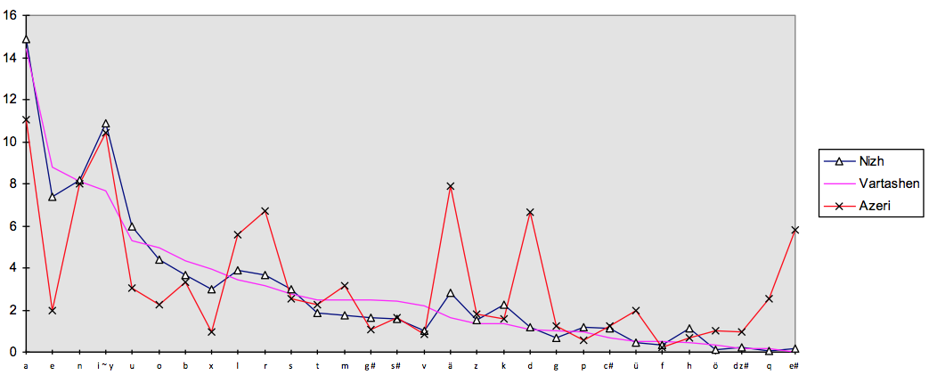
Udi (2)
Usage-based frequency of phonemes (Udi/Azeri)

Slide 25
Udi (2)
Lexicon:
Udi dictionaries
Gukasjan 1 Mobili
1974 2010
(Non-Azeri
incl. loans from Armenian, Russian etc.) 73,7 % 62,4 %
Azeri/Oriental 26,3 % 37,6 %
Loans cover all domains over everday life and cannot be related to specific conceptual domains or domains of cultural/social practices.

Slide 26
Udi (2)
Morphology: Derivation mainly based on Azeri morphemes
Else: Significant formal differences, but structural affinities, confer:
Udi: (bez) xaʕ te-zax-p´u
I.POSS dog NEG-I.DAT-COP.PRES
Azeri mən-im it-im yox-dur
I-1.SG.POSS dog-1SG.POSS be=not-COP.PRES
‚I don‘t have a dog.‘
Udi: meyvan-a uk‘-i-zu
fruit-O.DEF eat-PAST-1SG
Azeri meyvən-i ye-di-m
fruit-O.DEF eat-PAST-1SG
‚I ate the fruit.‘
„water-without“ (‚waterless‘)
xe-nut‘ (U+U)
xe-suz (U+A)
su-nut‘ (A + U)
su-suz (A + A)

Slide 27
Udi (2)
Question:
What is ‚Udi‘ for a speaker of Udi?
Problem:
S1: venk´ ek´a-a udi-n muz?
you.SG.BEN what-3SG.Q Udi-GEN language
‚What is the Udi language for you?‘
S2: t´e muz-e ma-t‘-in-te
DIST language-3SG which-SA-ERG-SUB
yoldaš-muǧ-oxol ixt´ilät-zu-b-sa
friend-PL-COM conversation-1SG-do-PRES
‚That language I use when talking to friends.‘

Slide 28
Udi (2)
Hence: Is Udi a „variety according to use“ (‚stylistic variant’) / Functional native bilingualism /
rather than
a „variety according to user“ (in terms of first language acquisition)
(cf. Halliday/McIntosh/Strevens 1994: 87) ??????
Cf.: mot´ǧoxol metär ixt´ilätzubsa, šot´ğoxol t´etär.
‚With these, I speak this way, with those, I speak that way.‘ (Vartashen 1985)

Slide 29
Udi (2)
Question:
ek´enu čalxsa te vi yoldašen udin muzin
ixt´ilätt´ebsa?
‚How to you know that your friend speaks Udi?‘
Answer:
teza avabaksa....
‚I don‘t know.....‘

Slide 30
Udi (2)
Hence:
How do naive speakers define their language: Grammar or Lexicon or Phonetics/Phonology?
Udi: bütün ğarmuğo kağizzu campsa
Azeri: bütün oğlanlara məktub yazıram.
‚I write a letter to all the boys.‘
OK: bütun oğlan-ğ-o mäktub yazmiš-zu-b-sa
(Azeri lexicon, Udi grammar)
Not OK: *bitum ğar-lar-a kağiz cam-p-ir-am
(‚Udi‘ lexicon, Azeri grammar)

Slide 31
Udi (2)
Sociology of knowledge:
Karl Mannheim (1893-1947)
Communicative knowledge: explicit and reflective knowledge (‚knowing/talking ‚about‘, cf. Roland Barthes)
=> Most of lexicon/idioms etc., in parts phonetics.
Conjunctive knowledge: implicit, experiential knowledge grounded in everyday practices , non-reflective, praxeological (Barthes) (‚common sense’ > Habitus (Pierre Bourdieu))
=> Most of grammar (but not derivation!)

Slide 32
Udi (2)
Internal view (of speech community) on language:
Communicative knowledge:
A language is perceived as being ‚specific‘ when experiencing (and reflecting) marked differences esp. in the lexicon and in phonetics (not: phonology!)
The same holds for the external view (of other speech communities)
=> People identify a language due to the ‚otherness‘ of lexical and phonetic elements.
Conjunctive knowledge (=> Grammar) does not play a (relevant) role in identifying a particular language from on internal/external view.

Slide 33
Udi (2)
Given the fact that
- the Udi lexicon is massively Azeri-shaped
(=> communicative, explicit knowledge)
and
- the Udi grammar is (more or less) distinct from that of Azeri
(=> conjunctive, implicit knowledge)
we can ask:
Does the Udi speaker perceive the ‚Udiness‘ of Udi only in terms of lexical/idiomatic peculiarities?

Slide 34
Udi (2)
What would then (according to the communicative knowledge of Udi speakers) be the difference from a lexically/idiomatically marked variety of their Azeri practices?
Confer:
Jenish (German-based special language, here Swiss variant)
selber linst-ne ne z-gwand z-menge
I=myself look=at-it it to-intact to-do
German:
Ich schaute es (mir) an um es (wieder) ganz zu machen

Slide 35
Udi (2)
So:
What is endangered in Udi?
Features:
- Loss of non-Azeri lexical units when using the ‚Udi style‘?
(Better: ongoing process of replacing non-Azeri lexical units by Azeri terms)
But: What are ‚native‘ terms in Udi? What about older loans (e.g. Iranian, Armenian)? Are they ‚Udi‘?
- Loss of conjunctive knowledge of Udi grammar.
But: The grammar of Udi has resulted from very many patterns of language contact. What would then be ‚Udi‘ in the grammar of Udi?
- Ongoing assimilation to articulatory traditions of Azeri.

Slide 36
Udi (2)
Language awareness:
The idea that Udi has a surplus for the speech community has been implemented in the community especially after 1989:
- The Udi language as a testimony of the Albanian heritage in Azerbaijan.
- Adaptation of European models of language as a parameter of (national or sub-national) identity.
- Turning conjunctive (praxeological) knowledge into communicative knowledge ‚about Udi‘.
- Implementation of the idea of Udi as being a genuine part, testimony, and ‚storehouse‘ (Herder) of ‚Udi culture‘.
- Promoted by Udi intellectuals trained in big cities
=> Institutionalization of ‚Udihood‘

Slide 37
Udi (2)
Conclusion:
From a praxeological point of view, Udi is on its way of turning into a marked local communicative style that will be used as long as it has corresponding social funtions (variety in usage).
There are no ‚cultural‘ terms that cannot be translated into Azeri
‚Loss‘ of Udi (better: ongoing Azerfication of Udi) does not implicate a relevant ‚loss of cultural traditions‘
Only problem: Which language to be used in church services?
Maybe that what we assume as ‚Udi‘ will only survive as a newly shaped religious language (if ever popes will be trained on the basis of Udi)

